Slide 1
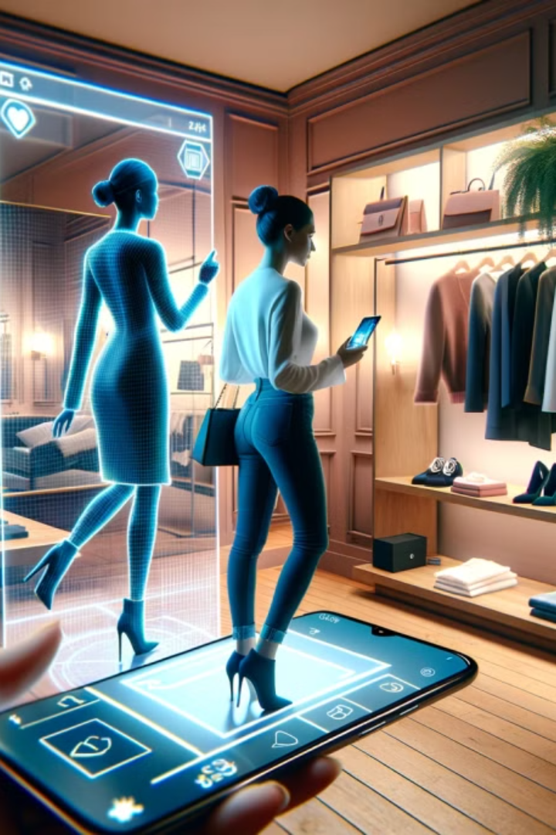
AI-Powered Virtual Try-On in Fashion
The fashion industry is transformed by AI and AR. This project creates an AI-powered try-on system to visualize clothes digitally, enhancing shopping and reducing returns.

Slide 2
Project Objectives
Digital Try-On
Enhanced Shopping
Deep Learning Integration
Enable users to try clothing virtually without physical wear.
Use AR and computer vision for immersive online experiences.
Precisely segment body and overlay garments.
Interactive Interface
Cross-Platform Deployment
Real-time visualization with user-friendly controls.
Mobile and web support using TensorFlow Lite and WebAR.

Slide 3
Methodology Overview
Data Collection & Preprocessing
Model Training & Integration
Deployment
Utilize datasets DeepFashion2 and VITON-HD; segment images and extract body features.
Train VITON-HD and TryOnGAN for pose estimation and garment fitting. Use OpenCV, MediaPipe, and ARKit/WebAR for real-time overlay.
Create apps using React Native and Flask; optimize with TensorFlow Lite for mobiles.

Slide 4
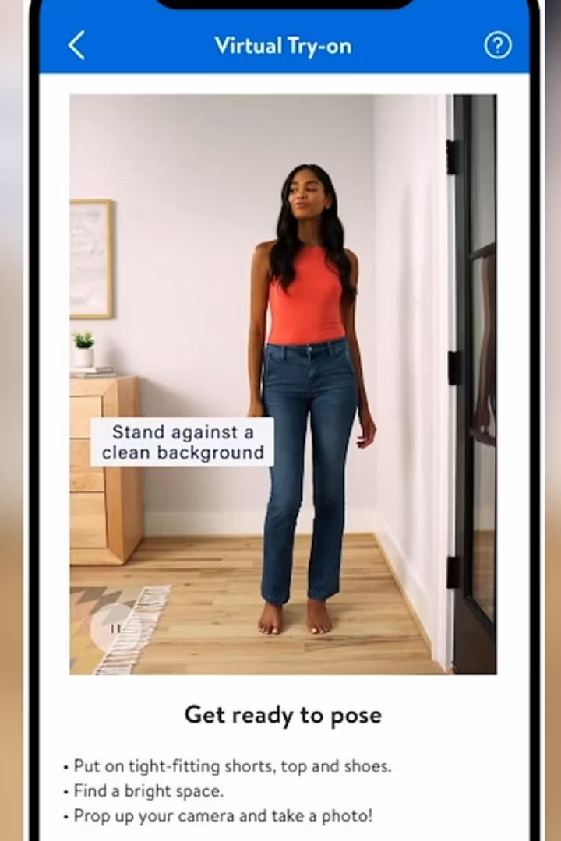
Key Findings
Improved Engagement
Real-Time Precision
Virtual try-on boosts customer interaction and satisfaction.
Deep learning models accurately overlay garments instantly.
Efficient Pose Estimation
OpenCV and MediaPipe enhance pose detection speed and accuracy.

Slide 5
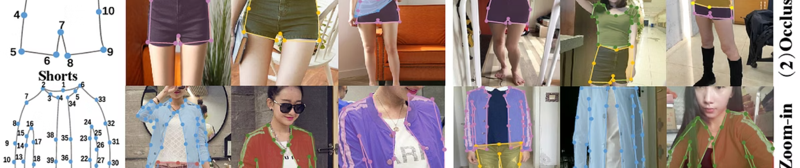
Step-wise Solution Approach: Data & Preprocessing
Pose Estimation
Image Segmentation
Employ OpenPose or MediaPipe to detect user body posture.
Gather Data
Apply algorithms to isolate clothing and body regions.
Use DeepFashion2 dataset for diverse clothing images.

Slide 6
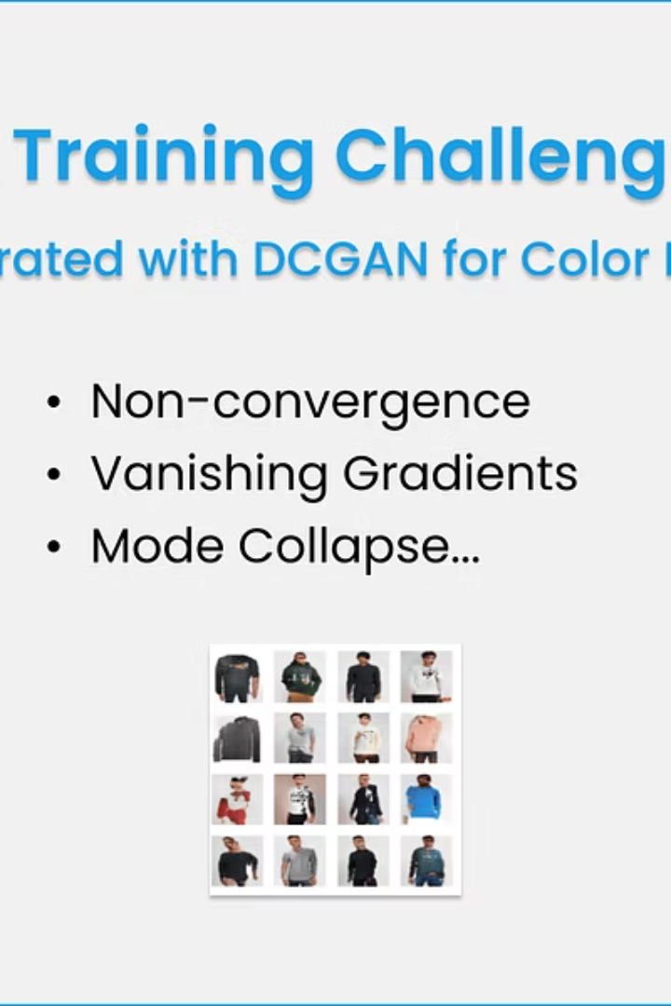
Step-wise Solution Approach: Model Training
1
TensorFlow & VITON-HD
Train networks for accurate garment overlay and transformation.
2
GAN Fine-Tuning
Enhance realism using adversarial training on virtual try-on models.

Slide 7
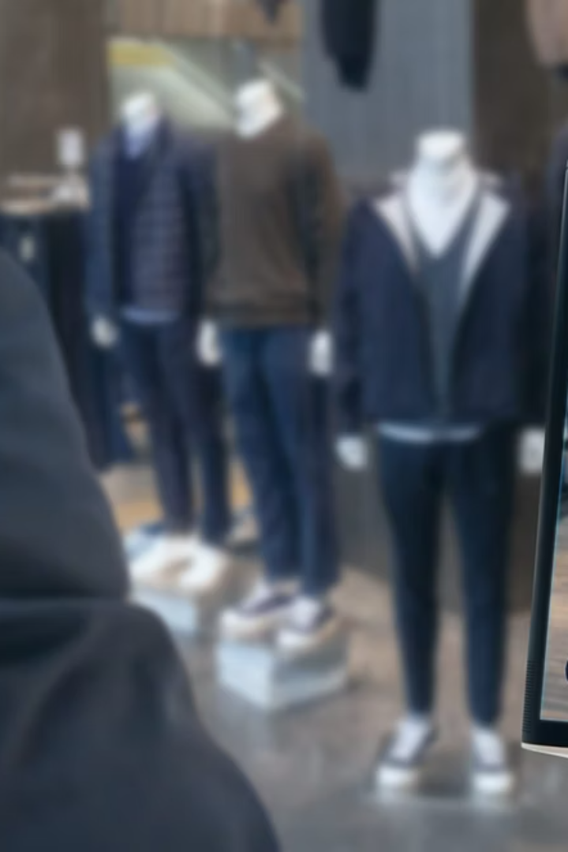



Step-wise Solution Approach: AR Integration & Deployment
Pose Tracking
Combine OpenCV and MediaPipe for responsive real-time tracking.
App Development
Build React Native frontend and Flask backend for smooth UX.
Mobile Optimization
Deploy TensorFlow Lite and WebAR for efficient mobile experiences.

Slide 8
Team and Project Impact
Team Members
Future Potential
Abimanyu T - E22CSEU1003
This AI-powered try-on system transforms e-commerce and retail.
Vinoth M - E22CSEU1477
It reduces returns, boosts sales, and improves shopper confidence.

